Slide 1
BASIC UNIX & SHELL PROGRAMMING

Slide 2
Introduction to OS concepts
Introduction to Unix Operating System
Unix System Architecture
Introduction to Unix File System
Starting to work with unix

Slide 3
Operating System
Is a System software
Can be defined as
  An Organized collection of software consisting of procedures for operating a computer
Provides an environment for execution of programs
Acts as an interface between the user and the hardware of the computer system.

Slide 4
Operating System
Operating system interacts with the user in two ways
  Operating system calls
  Provides an interface to a running program and the operating system. System calls in UNIX is written in C.
  Operating system commands
  Enables the user to interact directly with the operating system.

Slide 5
History of Unix
  Ken Thompson of AT&T ,BELL laboratories originally designed unix os in late 1960s which evolved from timesharing os called multics.
  Originally written in assembly language but with the development of ‘c’ programming language in 1973,it was then written in ‘c’.
  Two versions of UNIX emerged are AT&T Unix
  and BSD Unix

Slide 6
History of Unix
  1989 AT&T and Sun Micro system joined together and developed system V release 4 (SVR4)
  Two of the main standards mainly in use are POSIX(Portable Operating System Interface) and X/open standard
  1988 MIT formed Xconsortium which developed vendor Neutral Xwindow System

Slide 7
Features of Unix system
Multi-user /multitasking/timesharing concept
Portability
Modularity
File structure
Security
Strong networking support
Advance graphics

Slide 8
Unix Operating System
Multi-user, Multiprocessing Operating System
Consists of several dumb terminals attached to it.
Written in high-level language C
Uses hierarchical file system - allows easy maintenance and efficient implementation

Slide 9
Unix System Architecture
Unix System follows a layered Approach
It has four layers
The innermost layer is the hardware layer
In the second layer, the kernel is placed.
The utilities and the other application programs form the third layer
Fourth layer is the one with which the user actually interacts.

Slide 10
Layered Architecture
...
banner
ls
cp
kernel
sort
comp
sh
cc
hardware
as
who
ld
a.out
vi
date
Other
application
programs
ed
grep
wc

Slide 11
Kernel
Kernel is that part of the OS which directly makes interface with the hardware system.
Factions:
  Provides mechanism for creating and deleting processes
  Provides processor scheduling, memory and IO management
  Does interprocess communication.

Slide 12
The Shell
A Utility program that comes with the unix system.
Features of Shell are:
  Interactive Processing
  Background Processing
  I/O Redirection
  Pipes
  Shell Scripts
  Shell Variables
  Programming Constructs

Slide 13
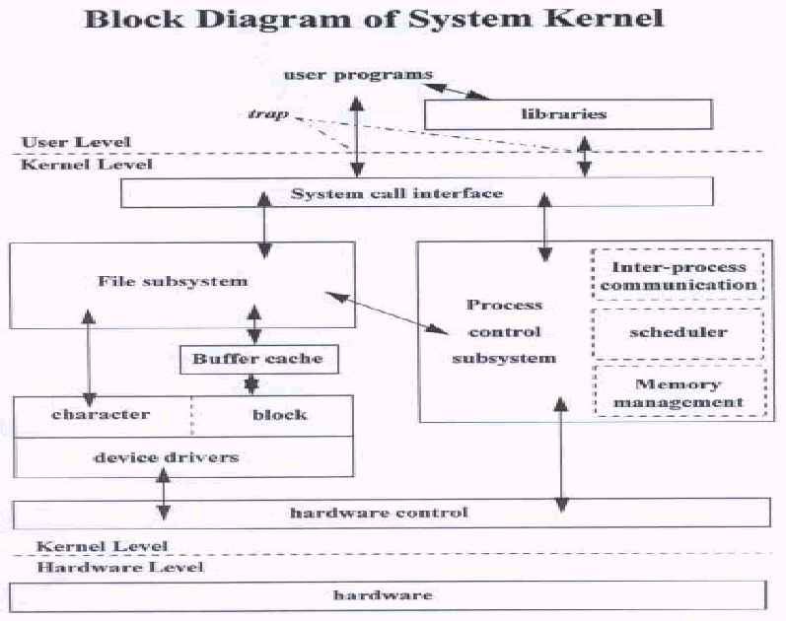
UNIX System Structure

Slide 14
Process Management
A process is a program in execution
Several processes can be executed simultaneously in a UNIX system.
A process is generally created using the “fork” system call.
The process that invoked the “fork” system call is the parent process and the newly created processed are called as child processes

Slide 15
CPU Scheduling
Unix uses “Round-Robin” scheduling to support its multi-user and time-sharing feature.
Round-Robin fashion of scheduling is considered to be oldest,simplest and widely used algorithm.
Here, every process is given a time slice(10-100 millisec.)

Slide 16
Memory Management
Swapping
Demand Paging

Slide 17
File Management
Unix uses a hierarchical file system with “/” as its root.
Every non-leaf node of the tree is called as a directory file.
Every leaf node can either be a file or an empty directory

Slide 18
UNIX file system
dev
bin
tmp
home
etc
lib
usr
bin
sh
init
console
ls
password
user1
lp0
user2

Slide 19
UNIX file system
File system is the structure in which the files are stored in the disk
File in UNIX is sequence of bytes organized in the form of blocks.
The size of each block is 512 bytes (depends on architecture)
Block size can be decided while creating the file system structure

Slide 20
Most common implementations of Unix.
BSD: Berkeley, BSD
Solaris: Sun Microsystems, Sys 5/BSD
Ultrix: Digital Equipment Corperation, BSD
OSF 1: Digital Equipment Corperation, BSD/sys 5
HPUX: Hewlett-Packard, Sys 5
AIX: IBM, Sys 5 / BSD
IRIX: Silicon Graphics, Sys 5
GNU/Linux: GNU, BSD/Posix

Slide 21
Types of users in unix
System administrator
The Owner
Group Owner
other users

Slide 22
Working with UNIX
Log in
Log out

Slide 23
UNIX COMMANDS
Section 1

Slide 24
Simple Commands
pwd
  Identifies the current working directory.
date
  Displays the current date and time
who
  Displays the names of all the users who have currently logged in
who am i
  Displays the name of the current user.

Slide 25
Listing the Contents
ls
Syntax :ls [options] [file….]
options: -l list in long format
-a list all file including those beginning with a dot
-i list inode no of file in first column
-s reports disk blocks occupied by file
-R recursively list all sub directories
-F mark type of each file
-C display files in columns

Slide 26
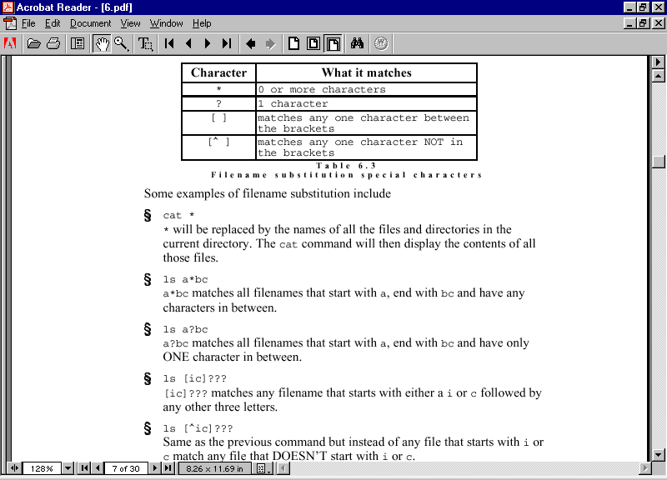

Slide 27
Listing the Contents
groupid
$ ls –l
total 6
-rwxr-xr-x 1 user1 training 12373 Dec 15 14:45 a.out
drwxr-xr-x 2 user1 training 4096 Dec 22 14:00 awkpro
-rw-r--r-- 1 user1 training 12831 Dec 12 13:59 c
-rw------- 1 user1 training 61440 Dec 15 11:16 core
-rw-r--r-- 1 user1 training 255 Dec 20 14:29 cs
Link counter
File name
Size in bytes
userid
File access permission
Date &Time of Change
Type of file

Slide 28
Help
The Unix manual, usually called man pages, is available on-line to explain the usage of the Unix system and commands. To use a man page, type the command "man" at the system prompt followed by the command for which you need information.
Syntax:
  man [options] command_name
Common Options
-k keyword list command synopsis line for all keyword matches
-M path path to man pages
-a show all matching man pages (SVR4)

Slide 29
Files & Directories

Slide 30
Objectives
File Permissions
Directory Related Commands
File Related Commands
Introduction to editors

Slide 31

File Access Permissions
Refers to the permissions associated with a file with respect to the following
Permission Levels
  User (owner) (u)
  Group (wheel, staff, daemon, etc.) (g)
  World (guest, anonymous and all other users) (o)
Permission Settings
  Read (r)
  Write (w)
  Execute (x)

Slide 32
File Access Permissions
No read permission does not allow the user to:
  List the contents of directory
  Remove the directory

Slide 33
File Access Permissions
No Write permission does not allow the user to :
  copy files to the directory
  remove files from the directory
  rename files in the directory
  make a subdirectory
  remove a subdirectory from the directory
  move files to and from the directory

Slide 34
File Access Permissions
No execute permission does not allow the user to:
  display the contents of a directory file from within the directory
  change to the directory
  display a file in the directory
  copy a file to or from the directory

Slide 35
Changing the permission --chmod
FAP can be changed using a “chmod” command.
To change the FAP,
  Type of the user
  Type of the permission
  Whether the permission has to be granted or revoked
  The name of the file, has to be specified.
Ex: chmod u+x file_name
Syntax:
chmod <category> <operation> <permission> <filename(s)>

Slide 36
MAKING A DIRECTORY
Command Syntax
mkdir [OPTION] DIRECTORY
$mkdir <path>/<directory>
$mkdir –m <directory>
$mkdir –p <directory1>/<directory2>/<directory3>
Example:
  mkdir project1
This creates a directory project1 under current directory

Slide 37
Permissions to Create Directory
Write and Execute permission is needed in the parent directory

Slide 38
REMOVING A DIRECTORY
rmdir command removes directory
Syntax
  rmdir <directory name>
Example
Removes project1 directory in the current directory
  rmdir project1
Remove multiple directories
rmdir pos1 pos2
Remove the directory recursively
rmdir –p dir1/dir2/dir2
Rule: rmdir can be executed to a directory if it is empty and not the current directory

Slide 39
File Related Commands
FILE OPERATIONS
Copying a file
Moving a file
Removing a file
Displaying a file
COMMANDS
cp
mv
rm
cat

Slide 40
Command (cp)
Used to copy files across directories
Syntax
cp <source file> <new file name>
Example
cp file1 file2
Note:
cp -r /dev/tty myfile

Slide 41
Command (cp) Options
-p
Copies the file and the following details
  owner id
  group id
  permissions
  Last modification time

Slide 42
Command (mv)
Used to move a file or rename a file
Preserves the following details
  owner id
  group id
  permissions
  Last modification time
-f suppresses all prompting
-i prompts before overwriting destination file

Slide 43
Command (rm)
Used to remove a file
  Syntax : rm file(s)
-f suppresses all prompting
-i prompts before overwriting destination file
-r will recursively remove the file from a directory (can be used to delete a directory along with the content )
Caution: Use “i” option along with “r” to get notified on deletion

Slide 44
chown & chgrp
$ ls –l total 156
-rwxr-xr-x 1user1 training 12373 Dec 15 14:45 a.out
-rwxr-xr-x 3 user1 faculty 4096 Dec 24 11:56 awkpro
$chown user2 a.out
$ls –l
-rwxr-xr-x 1user2 training 12373 Dec 15 14:45 a.out
-rwxr-xr-x 3 user1 faculty 4096 Dec 24 11:56 awkpro
$ chgrp training awkpro
$ls –l
-rwxr-xr-x 1user2 training 12373 Dec 15 14:45 a.out
-rwxr-xr-x 3 user1 training 4096 Dec 24 11:56 awkpro

Slide 45
umask
umask value is used to set the default permission of a file and directory while creating
umask command is used to see the default mask for the file permission
Default umask value will be set in the system environment file like /etc/profile
umask 022 will set a mask of 022 for the current session
  The file permission after setting this umask value will be 644
  And the directory permission will be 755

Slide 46
Special permission bits
SUID
  Set user id
SGID
  Set group id
Sticky bit/SVTX
  Sticky bit

Slide 47
The vi editor
Vi is a visual editor used to enter and edit text files.
  A screen-oriented text editor
  Included with most UNIX system distributions
  Command driven
Categories of commands include
  General administration
  Cursor movement
  Insert text
  Delete text
  Paste text
  Modify text
The vi editor is invoked by the following command
  vi <filename>

Slide 48
-vi Editor
-i -Inserts text to the left of the Cursor
-a -Inserts text to the right of the Cursor
-I- Inserts text at the beginning of the line
-A -Appends text at end of the line
-o -opens line below
-O -opens line above
R -Replaces text from cursor to right
s -Replaces a single character with any number of characters
S -Replaces Entire line

Slide 49
-vi Editor
:w - To save
:w! - To name a file
:x- Save and quit
:q - Cancel changes
:q! - cancel and quit

Slide 50
Deletion options
-x -To delete character at cursor position
-3x -To delete 3 characters at cursor position
-dw -To delete word
-2dw - To delete 2 word
dd - To delete a line
2dd - To delete 2 lines

Slide 51
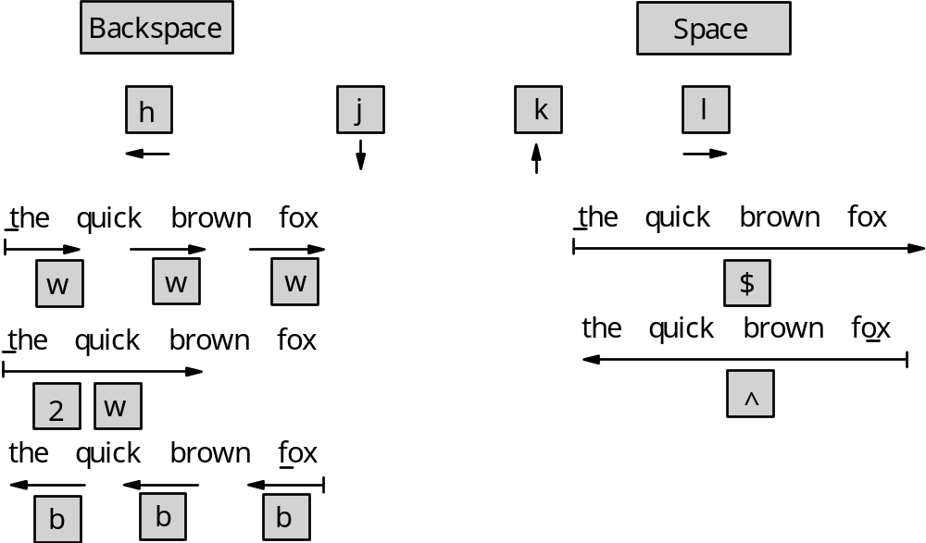
Navigation options

Slide 52
Unix Utilities

Slide 53
Objectives
General purpose utilities
  cat, echo, touch, more, file, wc, cmp, comm, find, banner, cal etc..
Redirection operators
Filters

Slide 54
cat
cat is concatenate files and print on the standard output
cat command takes the input from the keyboard and send the output to the monitor
We can redirect the input and output using the redirection operators
  $ cat>file1
  Type the content here
  press <ctrl d>
  $ cat file1
  Displays the content of the file
  $cat>>file1
  Will append to the content of the file

Slide 55
touch
Syntax: touch [options] file
Options:
  a to change the access time
  m to change the modification time
  c no create if not exists
touch is used to change the time stamp of the file
Touch <file> will change the time of change of the file is the file exists
If the file is not existing it will create a file of zero size

Slide 56
echo
echo command is used to print an output to the screen
  $echo “This is an example”
  This is an example
  $x=10
  $echo $x
  10

Slide 57
General Purpose Utilities
More
  Allows the user to view one page full of information at a time.
File
  Used to display the type of the file.

Slide 58
General Purpose Utilities
wc
  A filter used to count the number of lines,words and characters in a disk file or in the standard input.
  -l - displays the number of lines
  -w - displays the number of words
  -c - displays the number of characters

Slide 59
General Purpose Utilities
Cmp
  Returns the offset and the line number and the line number of the first position where the two files differs.
Comm
  col1 - unique lines of first file
  col2 - unique lines of second file
  col3 - common lines

Slide 60
General Purpose Utilities
diff
  Indicate the differences between the files
  a Lines added
  d Lines deleted
  c Lines changed

Slide 61
General Purpose Utilities
find
  Used to locate a file or a directory in the given path
Usage
  find <path> [options]
Options
  name - accepts the format to searched
  print displays the path on the screen

Slide 62
General Purpose Utilities
pr
  Used to display a file in a format to be printed.
  Breaks up a file into pages with a header, text and footer area.
Options
  l to alter the length of the file
  h to set the header
  -t to suppress the header and the footer

Slide 63
General Purpose Utilities
banner
  Creates posters by blowing up the argument
  Usage
  banner HELLO
cal
  Prints the calendar of any particular month or year.
  Ex: cal 2001 or cal 01 2001

Slide 64
Misc. Commands
nl -----------→Number the lines of files
bc ---------→ Binary Calculator
factor -----→ Factors of a number
units ------→Unit conversion program (rupee -> dollar)
log name---→ Prints login id of the user
uname -----→ Prints System information
tty ------→ Prints the current terminal

Slide 65
Standard Files
Standard Input file
  Keyboard , file descriptor is 0
Standard Output file
  Monitor , file descriptor is 1
Standard Error file
  Monitor, file descriptor is 2

Slide 66
I/O Redirection
Input Redirection
  Symbol used is <
Output Redirection
  Symbol used is > for writing
  >> for appending
Error Redirection
  Symbol used is 2>

Slide 67
Filters
Filters are programs that takes its input from the std i/p file, processes it and sends it to the std o/p file.
Commonly used Filter Commands
  Sort
  Grep
  Cut
  Head
  Tail
  Uniq
  paste

Slide 68
Sort
Sorts the contents of the given file based on the first char of each line.
-n --numeric sort
-r --Reverse sort
-t -Specify delimiter for fields
+num -specify sorting field numbers
+num -num - to specify the range
can specify the characters in the field

Slide 69
-grep
Grep -Global Regular Expression Printer
Is used for searching regular expressions
Syntax
  grep <options> <pattern> <filename(s)>

Slide 70
Options in grep
c Displays count of the number of occurrences
n Displays line numbers along with the lines
v Displays all lines except lines matching pattern
i Ignores case for matching

Slide 71
Patterns
* - matches 0 or more characters
[^pqr] - Matches a single character which is not p ,q or r
^pqr -Matches pqr at the beginning of the line
pqr$ -Matches pqr at the end of the file
“.” - Matches any one character
\ - ignores the special meaning.
  Grep “New\[abc\]” filename

Slide 72
-head command
Displays the top n lines of the file
Can specify top n lines to be displayed
head -3 file1

Slide 73
-tail command
Displays the end of the file
Can specify last n lines to be displayed
tail -3 file1
Can also specify the line number from which the data has to be displayed
tail +5 file1

Slide 74
cut command
Used to extract specified columns from the o/p of certain commands
-c used to extract characters
-d Delimiter for fields
-f Field no.
Examples
cut -c2-5 file1
cut -d “|” -f2,3 file1

Slide 75
Paste command
Paste is used to fix two cut portions of the file vertically
-s -->Pastes the contents of file2 below file1
-d -->Specify delimiter
paste -d”|” file1 file2

Slide 76
tr
tr - Transtlate filter used to translate a given set of characters
usage :
  tr [a-z] [A-Z] filename
option -s can be used to squeeze the repeated characters.

Slide 77
PIPES
Allows the output (not error messages) of a command to be sent as input to another command.
A pipe designated by the character | is a temporary file in memory only , never on the disk.
Multiple pipes may appear in one command line.
Only output of the command is sent – not the errors.
Example:
$ cat * | wc
$cat fil1 | head | wc -l

Slide 78
TEE
tee command is used to
  Save the standard output in a file
  Display the output on the Terminal or file or to a process
  tee uses standard input and standard output
Example
  who | tee userlist
  cat - | tee file1 | wc -l

Slide 79
Communication
The news command
  Normally invoked by the user to read any message that is sent by the sa.
  Contents of will be stored in a file under the /usr/news folder (/var/spool/news)
  Displays only the unread messages.

Slide 80
Communication
motd
  message of the day
  Similar to news, but will be displayed as soon as the user logs in.
  System Administrator should maintain these messages.
  User can only view the messages

Slide 81
Write
write enables two way communication
Press ctrl-d to end the conversation
When more than one users have logged in with the same id, use the terminal type to identify the users individually.
  write user1 pts/0

Slide 82
mesg
“mesg “ command can be used to insulate a terminal from receiving messages
can be set as
  mesg [ny]
mesg without parameters will give the current status

Slide 83
mail
Mail is used to send offline message to the user.
If a new mail has arrived, the user gets a message saying, you have a mail
The message will be stored in the folder /usr/mail or /var/spool/mail

Slide 84
pine
“pine” utility of Linux can also be used to work with mails.

Slide 85
wall
Wall command is used to flash message in all the logged in terminals
Wall command is used by the shutdown command to send message to the users

Slide 86
Other Utilities
du: Directory Usage
du [-ks] directory...
where
k : Use units of kb (1024 bytes) for size.
s : Display summary only.
directory
: The directory where du is to start reporting sizes.
The default behavior of du is to show the sizes of all directories,
beginning with the current directory.
Optionally, a starting point may be used (directory above).

Slide 87
df: Disk Space
df (SUN, Linux)
df -k (SGI)
bdf (HP)
displays the current usage of disk drives used on the system. The output is usually in blocks (512 or 1024 bytes, depending on the vendor) and includes both used and free space for each of the logical/virtual drives installed and configured.
The directory onto which the drive is attached to the filesystem is shown as the last field of the output.
$ df -k
Filesystem Type kbytes use avail %use Mounted on
/dev/root efs 471376 445886 25490 95% /
/dev/dsk/lv1 efs 1975050 1362496 612554 69% /usr2

Slide 88
telnet: Connecting to Remote Systems - (non-secure)
telnet hostname
Allows a connection to host from any other machine connected to the Internet. node itself will prompt for a logon name, then the password.
Logging on remotely allows users to use the UNIX/Linux commands, but not the Graphics User Interface of the remote machine.
rlogin: Bypassing Password - (non-secure)
rlogin node
Allows a connection to node without the use of a password. For this to be true, two things must be properly set.
1.You must have an account (of the same name) on the remote system.
2.File .rhosts on the remote system must contain the name of the local system, followed by your account name.

Slide 89
FTP
ftp hostname
put/send: Transfer to Other hosts
put [local_file [remote_file]]
get/recv: Transfer From Other hosts
get [remote_file [local_file]]
mput: Multiple Transfer to Other hosts
It will prompt for every file to be transferred, unless the -i flag was used
on the ftp command line, or the prompt command is issued.
mput is very useful when moving a number of files.

Slide 90
Compression Utilities
It is sometimes useful to reduce the amount of space taken by specific files.
In fact, most public domain packages downloaded using ftp or another method have been compressed with a utility.
gzip, gunzip
Because of proprietary code in the compress utility, the Free Software Foundation, as part of their GNU project, wrote the gzip/gunzip utilities, and made them available to end users at no charge.
Usage is very similar to compress and pack utilities in unix:
gzip [-vc] filename
where -v displays the compression ratio.
-c sends the compressed output to standard output and leaves the original file intact.

Slide 91
Gunzip
gunzip can uncompress files originally compressed with compress.
In general gzip does a slightly better job at compressing files (when compared to compress and pack).
tar: Tape Archive
tar is a utility that packs a list of files (and/or directories) into a specific tarfile, whose name typically ends in .tar.
tar is invoked by
tar -c|t|x [vof destination] source...
where destination is the name of the tape device or tar file, and source... may be files and/or directories combined to produce the tar file. One of c, t, or x must be used.

Slide 92
-c (create): creates a new tarfile.
-t (table): lists the files on the tarfile.
-x (extract): extracts the files from the tarfile.
-v (verbose): the size and name of each file put onto or extracted from the tarfile is displayed.
-o (ownership): on the extraction of files, do NOT extract the original ownership of the files and directories. This avoids the message permission denied when reading tar_files.
-f (destination): uses the next argument as the name of the tarfile.
It is normally in the form filename.tar (but could also be a device name, such as /dev/8mm).

Slide 93
For example
To write the files utilities.tex and course.tex onto file save.tar, use
tar -cvf save.tar utilities.tex course.tex
A tarfile may exist as a file in your directory. tar by itself only creates an archive from a file or files (to to this, put a file name on the command line instead of device).
The archive may be on disk, or in a directory. Such a file typically ends with .tar.
To read the files back onto another system (or elsewhere in the same system):
tar -xvf save.tar
To list the contents of the file:
tar -tvf save.tar
tar -xvf /dev/tapens

Slide 94
Processes

Slide 95
Objectives
Processes
  ps
  kill
  wait
  sleep

Slide 96
Process
Process - a program in execution
When program is executed , a new process is created
The process is alive till the execution of the program is complete
Each process is identified by a number called pid.

Slide 97
sh process
As soon as the user logs in, a process called sh is created.
sh is a UNIX command available in the /usr/bin directory
sh can also be used explicitly to invoke another shell

Slide 98
ps
The ps command is used to display the characteristics of a process
It fetches the pid, tty, time and the command which has started the process.
  -f lists the pid of the parent process also.
  -u lists the processes of a given user
  -a lists the processes of all the users
  -e lists all the processes including the system processes

Slide 99
Background Processes
Enables the user to do more than one task at a time.
If the command terminates with a & UNIX starts processing the command at the background

Slide 100
Controlling background process
jobs
  List the background process
fg %
  Runs a process in the foreground
bg %
  Runs a process in the background
nice

Slide 101
Kill command
kill : Kills or terminates a process
Kill command send a signal to the process
  The default signal is 15 ( SIGTERM)
Kill -9 (SIGKILL)
  Terminates the process abruptly

Slide 102
Sample /etc/passwd file
root:x:0:0:root:/root:/bin/bash
xfs:x:43:43:X Font Server:/etc/X11/fs:/bin/false
suresh:x:500:500:SURESH:/home/suresh:/bin/bash
perumal:x:501:501::/home/perumal:/bin/bash
user:x:502:502::/home/user:/bin/bash
user1:x:503:503::/home/user1:/bin/bash

Slide 103
Fields of sample etc/passwd file
First field represents the login id of user
second represents an encrypted password field
third field represents UID no.
fourth field represents the group identification no,
the next field is a comment field which can be used to give the user’s fullname.
Sixth field specifies user’s home directory.
Seventh field represents the program the system runs when the user logs in.

Slide 104
Shell Scripting

Slide 105
Different shells
Bourne shell sh developed by Stephen Bourne
C shell csh ,, ,, Bill Joy
Korn shell ksh ,, ,, David korn
Bourne again bash Shell distributed with linux shell

Slide 106
Basic Shell Features
Displays the shell prompt and reads the command typed by the user.
Interprets the command and classifies it as internal (built-in) or external command.
If it is a NOT a built-in command, searches for the command in the PATH specified directories and executes that command if it is found.

Slide 107
Basic Shell Features
If it is a built-in command, executes the command.
Waits for the command to finish – if the command was NOT started as a background job.
When the command finishes, displays the shell prompt again. However, displays the prompt immediately if the command was started as a background job.

Slide 108
Shell Features
Parent shell process
(bash)
$ vi test.c
command typed by user
fork
Child shell process
(bash)
Exec of “vi test.c”
User Mode
Kernel Mode

Slide 109
Additional Shell Features
Each shell, apart from the basic features, provides additional features such as:
  Maintaining command history (C, korn and bash)
  Renaming (aliasing) a command (C and korn)
  Command editing (C, korn and bash)
  Programming language (all shells)

Slide 110
history
The history concept provides the user with the capability of calling
and editing previously used commands, modifying others, listing
the last commands used, and so on. Here are some of the
commands using the C shell history concept:
!!: recall the last command and execute it.
!num: where num is a number, recall and execute
command number num.
history recalls and list the last commands used.

Slide 111
alias
The alias mechanism provides the user with the ability to rename a command, or change the default options of a command.
The list of aliases is usually defined in either the .cshrc file in the user's home directory and/or in /etc/cshrc (.bash_profile in linux)
alias [command def]
where command is the name of the new command, and
def is how it is to be executed. alias typed on a line by itself
will list all current aliases.
To create a new command called erase to work as the rm command:
alias erase rm
From that point on, typing erase will be the same as typing rm.
The unalias command cancels alias.

Slide 112
THE FUNCTIONS OF A SHELL
command line interpretation
program initiation
input-output redirection
pipeline connection
substitution of filenames
maintenance of variables
environment control
shell programming

Slide 113
Command Interpretation
The shell reads the command entered by the user.
The shell checks whether the command is a built-in shell command or not.
If the command is a built-in shell command, the shell executes the command.

Slide 114
Command Interpretation
If the command is not a built-in shell command, the shell looks up the list of directories specified by the PATH environment variable, and finds a program (having the same name as the command entered or looking up at an alias table) that will perform that command.
If the shell cannot find the command in the directories specified by PATH, it displays an error message. Otherwise it executes the command.

Slide 115
Command Execution
If the command is a built-in shell command, the shell itself performs the command.
If the command is not a built-in shell command, the shell passes on the command to the kernel by:
  Creating a new (child shell) process
  Requesting the kernel to execute the command in the new (child shell) process

Slide 116
Filename substitution
When the user enters a command string, the shell parses the string into following components:
  Command(the first part of the string)
  Command arguments (the subsequent parts of the string)
For example, if you enter a command-string such as “ls –l *.c”, this string contains the “ls” command and two arguments “-l” and “*.c”.

Slide 117
Filename substitution
In arguments of a command, the shell recognizes certain characters – such as *, ?, [, ], and . - as special characters and expands these characters into a filename list before executing the command.
To see how this works, enter following commands:
  echo “this is a message”
  echo this is a message
  echo *

Slide 118
I/O Re-direction
The shell provides facilities to re-direct input, output and error for a command through special characters:
  Use > character to redirect output of a command to a file.
  Use < character to redirect input to a command from a file.
  Use >> characters to append output of a command to a file.
  The > and 2>&1 characters (Bourne Shell only) redirect output and error of a command to a file.

Slide 119
I/O Redirection-Examples
cat *.c > outfile
cat *.c >> outfile
cat nosuchfile > outfile
cat nosuchfile 2> outfile
cat * nosuchfile > outfile
cat * nosuchfile > outfile 2>&1
mail $user –s “testing IO redirection” < outfile
cat * nosuchfile >> outfile 2>&1

Slide 120
Input Redirection-Special Case
The shell supports a special case of input redirection that allows you to provide the input to a command from within a shell script.
For example, the cat command expects it’s input from the standard input (keyboard) or a file. Therefore, if you use the cat command as follows in a shell script, it will expect the input to come from the keyboard:
cat > outfile

Slide 121
Input Redirection-Special Case
In the previous example, if you wanted to provide input to the cat command from within the shell script itself, you can use << characters with a label. Consider following shell script:
  $ cat > outfile << _END_OF_DATA_
  This data comes from a shell script
  This data comes from a shell script
  _END_OF_DATA_
  $ cat outfile

Slide 122
Programming Language
The shell allows you to assign values to variables. This is the most basic feature required of a programming language.
The shell also provides other programming constructs including:
  Condition checking
  Loops
  Input and output statements

Slide 123
What is a shell script
A shell script is a text file containing a combination of following:
  Unix commands (such as ls, cat).
  Shell commands (such as variable assignment) and programming constructs (such as if statement and loops)
Since a shell script is a program, it is normally assigned execute permission using the chmod command.

Slide 124
Executing a shell script
There are two ways of executing a shell script:
  By passing the shell script name as an argument to the shell. For example:
    sh script1.sh
  If the shell script is assigned execute permission, it can be executed using it’s name. For example:
    ./script1.sh

Slide 125
Sample Shell Script
#! /bin/sh
#
# The above line has a special meaning. It must be the
# first line of the script. It says that the commands in
# this shell script should be executed by the Bourne
# shell (/bin/sh).
# ---------------------------------------------------------------
echo “Hello $USER….”
echo “I hope you like working with shell scripts..”
# ---------------------------------------------------------------

Slide 126
Shell Variables
Two types of variables
  Shell variables
  Environment variables
Shell allows variables to be defined and used
No type declarations or initializations are required before using them
= operator is used to assign values
Variables are evaluated by prefixing the name with a $

Slide 127
Using Normal Variables
To define a normal variable, use following syntax:
variable_name=value
Examples:
    $ x=10
    $ textline_1=‘This line was entered by $USER’
    $ textline_2=“This line was entered by $USER”
    $ allusers=`who`
    $ countusers=`who | wc –l`

Slide 128
Using Normal Variables
Having defined above variables, you can use the echo command to display the value of each variable:
    $ echo $x
    $ echo $textline_1
    $ echo $textline_2
    $ echo $allusers
    $ echo $countusers

Slide 129
Using Environment Variables
To define an environment variable, use following syntax:
variable_name=value
export variable_name
Examples:
    $ x=10; export x
    $ allusers=`who` ; export allusers

Slide 130
Built-in Environment Variables
Bourne shell provides a number of built-in environment variables. These include:
    PATH/usr/kerberos/bin:/usr/local/bin:/bin:/usr/bin:/usr/X11R6/bin:/home/girish/
    BASH_ENV=/home/girish/.bashrc
    HOME=/home/girish
    PWD
    SHELL=/bin/bash
    TERM=ansi
    MAIL=/var/spool/mail/girish
    USER=girish
    LOGNAME=girish

Slide 131
Shell meta-characters
The Bourne Shell recognizes a number of meta-characters. Each meta character can represent zero or more ordinary characters.
These meta characters are used in:
  Filename expansion
  Variable assignment
  Forming regular expressions etc.

Slide 132
Shell meta-characters
These meta-characters are:
  Asterisk - *
  Question Mark - ?
  Square brackets – [ and ]
  Single quote – ‘
  Double quote – “
  Back quote - `
  Back slash - \

Slide 133
Shell meta-characters
Examples:
    $ x=* ; echo $x
    $ x=?????? ; echo $x
    $ x=[a-p]????? ; echo $x
    $ x=‘$USER sold the book for $10’ ; echo $x
    $ x=“$USER sold the book for $10” ; echo $x
    $ x=“$USER sold the book for \$10” ; echo $x
    $ x=`who` ; echo “Current users = “ $x

Slide 134
Variable Naming Conventions
A Variable Name can consists of
  Alphabets,Numerals and underscore character
First character has to be a alphabet
Case - Sensitive
  name is different from NAME

Slide 135
Initializing and Displaying value to Shell Variables
There should be no blank spaces on either side of the = operator
If the value contains embedded spaces enclose them within “ or ‘ quotes
Example:
course=“Unix Fundamentals”
ans=You\ have\ a\ mail

Slide 136
Using variables with commands
pname=/home/user2/a
cd $pname
fname=“myfile1”
cat $fname

Slide 137
Assigning null values to Variables
All shell variables are initialized to null strings by default
Null values can be assigned by
  x=
  x=‘’
  x=“”

Slide 138
Concatenating Variables
company=Wipro\ Technologies\ Ltd
course=Unix\ Fundamentals
name=$course$company
or
name=“Unix Fundamentals”$company

Slide 139
Quoting
Commands can be stored in shell variables and can be executed
Example -1
  files=myfile1
  count=“wc $files”
    (the double quotes content will process the $variable)
  count1=`wc $files`
    (content in single quotes is considered as string constant)
  To Execute
    $count #gives the output of wc
    echo $count # prints wc myfile1
    echo $count1 #prints the output stored in $count1

Slide 140
Command substitution
    The output of a command can be substituted to a variable
    Eg:
    today=$(date)
    or
    today=`date` (grave accent)
    $ echo “Today is ‘date’”
    Today is Wed Dec 24 16:22:00 IST 2003

Slide 141
The expr command
Var3=$var1+$var2 will only concatenate the two variables
expr command is used to perform arithmetic operations on the shell variables
var3=`expr $var1 + $var2`
Notice: there should be space before and after the + symbol

Slide 142
Arithmetic Evaluation Using let
Syntax:
let expression or (( expression ))
Example:
$ x=10 $ x=12
$ y=2 $ let "x < 10"
$ let x=x+2 $ echo $?
$ echo $x 1
12 $ (( x > 10 ))
$ let "x = x / (y + 1)" $ echo $?
$ echo $x 0
4 $ if (( x > 10 ))
$ (( x = x + 1 )) > then echo x greater
$ echo $x > else echo x not greater
5 > fi
x greater

Slide 143
Conditional Operators
if statement
  used to evaluate a condition
Syntax
  #Testing if
if <condition is true>
  then
    <execute commands>
  else
    <execute commands>
  fi

Slide 144
Example for if statement
if grep ”data" myfle
then
echo "pattern found"
else
echo "pattern not found"
fi
Prints the output of grep and the message

Slide 145
The test command
test expression or [ expression ]
The test command evaluates the expression, and sets the return code.
Returns either 0 or 1
The test command can evaluate the condition of
Integers
Strings
Files
Return status is used by if statement for taking decision

Slide 146
The test Command – String Tests
Syntax:
[ string1 = string2 ] Determines string equivalence
[ string1 != string2 ] Determines string nonequivalence
Example:
$ X=abc $ X=abc
$ [ "$X" = "abc" ] $ [ "$X" != "abc" ]
$ echo $? $ echo $?
0 1

Slide 147
The test Command – File Tests
Syntax:
test -option filename Evaluates filename according
to option
Example:
$ test -f funfile
$ echo $?
0
$ test -d funfile
$ echo $?
1

Slide 148
Logical Operators
-a and operator
-o or operator
! not operator

Slide 149
Nested if
  if <condition is true>
  then
    <execute commands>
  elif <condition is true>
  then
    <execute commands>
  <...>
    <.....>
  else
    <execute commands>
  fi

Slide 150
The case Statement
case <expression> in
  <pattern1>) <execute commands>;;
  <pattern2>) <execute commands>;;
  <..............>
  <..............>
  *)<execute commands>
  esac

Slide 151
Shell Scripts
-Loops

Slide 152
Objectives
Introduction to shell scripts
  while
  for
  until
  set and shift statements

Slide 153
while
while test condition
do
statements
done

Slide 154
until
until condition
do
statements
done

Slide 155
for
for variable in list
do
statements
Done

Slide 156
set and shift
set statement converts its arguments into positional parameters
used as
  set val1 val2 val3 val4
  can set upto 9 values
The values can be accessed using the $ and the position of the parameter
$* and $#
“shift” can be used to access the values after the 9th position

Slide 157
Other $ values
echo $$
  Will return the pid of the current shell
echo $!
  Will return the pid of the previous background process
echo $!
  Will return the status of the previous command
    0 if successful
    >0 if error

Slide 158
Using shell functions
Shell functions are a way to group commands for later execution using a single name for the group. They are executed just like a "regular" command.
Shell functions are executed in the current shell context; no new process is created to interpret them. Functions are declared using this syntax:
[ function ] name () { command-list; }

Slide 159
Debugging Shell Scripts
At times you may need to debug a program to find and correct errors. Two options to the sh command can help you debug a program:
sh -v shell_script_name
The “-v” (verbose) option prints the shell input lines as they are read by the system.

Slide 160
Debugging Shell Scripts
sh -x shell_script_name
The “-x” (execute) option prints the commands and their arguments as they are executed.
To try these two options, create a shell program that has an error in it.

Slide 161
Comparison between
A solution in C
A shell solution written like a C pgm
A proper “shell/unix” solution
e.g:
The problem is to count the no of lines in a file ( the file is called the_file)

Slide 162
A solution in C
#include <stdio.h> -- void main(void)
{
int lcount=0;
FILE *infile;
char line[500];
infile=fopen("the_file","r");
while(!feof(infile))
{
fgets(line,500,infile);
lcount ++;
}
printf("no of lines is %d\n",lcount);
}

Slide 163
A shell solution
count=0
while read line
do
count=`expr $count + 1` or count=$[ $count + 1 ]
done < the_file
echo Number of lines is $count
Proper shell/unix solution
wc -l the_file

Slide 164
Advanced Filters

Slide 165
Objectives
Advanced filters
  egrep
  fgrep
  sed

Slide 166
Advanced Filters
egrep
  Extended Grep used to search for more than one patterns at a time
  used as egrep ‘pattern1|pattern2’ filename
Options used
  n - prints the line numbers
  c - count of lines matching the pattern
  v - inverses the output of the search

Slide 167
Advanced Filters
fgrep - similar to the egrep command
Alternate patterns are seperated by a new line character.
Usage:
  $fgrep ‘a
  >b ‘ filename

Slide 168
SED
SED -Stream Editor
Operates on a Data Stream
Performs Non-Interactive operations

Slide 169
sed Instruction
sed instruction has 2 components
  address command <optional>
    Specifies action to be applied on matching lines
  action
    Internal commands

Slide 170
Command
q -Quits after reading a addressed line
p-Prints line in standard output

Slide 171
Examples
sed ‘3q’ file1
  reads three lines and quits
  sed -n ‘1,3p’ file1
  outputs first 3 lines to standard output
  sed -n ‘1,3!p’ file1
  displays all the lines except first 3 lines
  n=3
  sed -n “1,$n p” file1

Slide 172
Executing multiple instructions
  (i) $sed -n ‘1,2p
  >4,5p
  >$p’ file1
  or
  (ii)use -e option to specify many instructions
  sed -n -e ‘4,p’ -e ‘$p’ file1

Slide 173
Writing data
Option “w” can be used with sed to write selected records/lines into a new file.
Used as
  sed -n ‘pattern filename’ source_filename
  sed -n '/KI[NR]*/w klist' db

Slide 174
Appending records
$sed ‘$a\
>vimal 4545\
>subha 4545
‘ file1

Slide 175
Inserting Records
Inserts records before the line
$sed ‘3i\
>-----------------------------------------
>’ file1

Slide 176
Deleting records
Deletes line 1 from file
  sed '1d' file
  sed ‘1,2d’ file

Slide 177
Context Addressing
Allows address lines by context
Enclose each expression within a pair of /’s
Can use wild card characters
Example
To select lines beween raki and rani
$sed -n '/rani/,/rani/p' file

Slide 178
Invoking commands from a file
$vi flist
/test/w fdlist
/temp/w ddlist
$sed -n -f flist file

Slide 179
Substitution and Regular
Expressions
sed ‘s/:/-/g’ file
  g-Substitute for all occurrences of character’
  Works like tr filter
To replace characters
sed 'y/aex/AEX/' file

Slide 180
AWK

Slide 181
Objectives
AWK
  Simple awk filtering
  printf
  Logical and Relational operators
  Number processing
  The BEGIN and END sections
  Positional parameters and shell variables
  getline
  Built-in variables
  Arrays & Functions
  Interface with the shell
  system() function & Control flow

Slide 182
AWK
AWK enables filtering and programming
Was added later into the UNIX system(1977)
Named after its authors,
  Aho
  Weinberger
  Kernighan

Slide 183
Simple awk filtering
Usage:
  awk <option> ‘line specifier {action}’ <file(s)>’
The line specifier is represented by context address. Eg /pat1/
The actions can be print, printf
The default action is print.
Eg: awk ‘/MANAGER {print}/’ db

Slide 184
Simple awk filtering
NR is used to specify the line numbers to be printed
-F option is used to specify the delimiter
$0 with print, prints all the columns
$n - where n is any number, can be used to print specific columns.
Eg:
  awk -F "|" 'NR==3,NR==6 {print $1,$2,$4,$6}' db

Slide 185
1. Simple awk program
{ print $0 } :awk1
awk -f awk1 /etc/group
2. Searching for a string within a file
format : /pattern/ {action}
/i/ {print $1 $2}
awk -f awk2 /etc/group
who| awk -fawk2

Slide 186
printf
printf statement can be used to format the output.
%d - is used for a number
%s - is used for a string
%c - a single character
%f - floating point number

Slide 187
Using Logical Operators
The logical operators used are
  || or gate
  && and gate
  ! Not gate
Example:
  awk -F "|" '$4 == "CLERK" || $4 == "ANALYST" {printf "%d %-12s\n", $1,$4}' klist

Slide 188
-f option
-f option is used to specify a file name.
Usage :
  awk [options] -f <filename> file(s)
Example: one.awk
  $4 == "CLERK" || $4 == "ANALYST" {printf "%d %f %-12s\n", ++ctr,$1*10.20,$4}
  awk -F “|” -f one.awk db

Slide 189
Awk’s built in arithmetic operators
cos(x)
exp(x)
int(x)
log(x)
rand(x)
sin(x)
sqrt(x)
eg : { print sqrt($1) } awk5
awk -f awk5

Slide 190
BEGIN and END
Can be used perform some action before or after the filtering
Ex: Printing a heading or some summary report at the end of the output.

Slide 191
Example
  BEGIN {
  printf "\n\t\tEmployee Details\n\n"
  }
  $7 > 1000 {
  cnt++;tot+=$7
  printf "%3d %-12s %6d\n",cnt,$3,$7
  }
  END {
  printf("\n\tThe Total Salary is %8\n",tot)
  printf("\n\tThe average basic pay is %6d\n\n\n", tot/cnt)}

